Slide 1
Going Beyond the Surface
Sustainable Technical Foam Solutions

Slide 2
Rules & speakers webinar
Webinar Speakers
Mathias Van Hecke
Strategy & Sustainability
Aneta Skora
Sales Manager CEE & Nordics
Iwona Szelag
Team leader Technical Foam
Webinar Rules

Slide 3
Agenda
Key Takeaways of the new Packaging & Packaging Waste Regulation (PPWR)
Deep Dive Gliwice (PL), the largest producer of Technical Foam
Video: Production Process of Technical Foam Gliwice
Technical Foam: Properties & Applications

Slide 4
Technical Foam is an integral part of our packaging products portfolio
Packaging
Contact Sound Insulation
Thermal Insulation
Industrial Foam Solutions
Foam
Flooring Underlay
XPS Boards
XPS Boards
Bubble
Screed Underlay
ISO-rolls
PP
Profiles
Side Strips
ISO-profiles
Technical Profiles
Technical Foam
Foam for Side Strips
Draught Stopper
Mailers
Dilatation Profiles

Slide 5
Key Takeaways of the PPWR

Slide 6
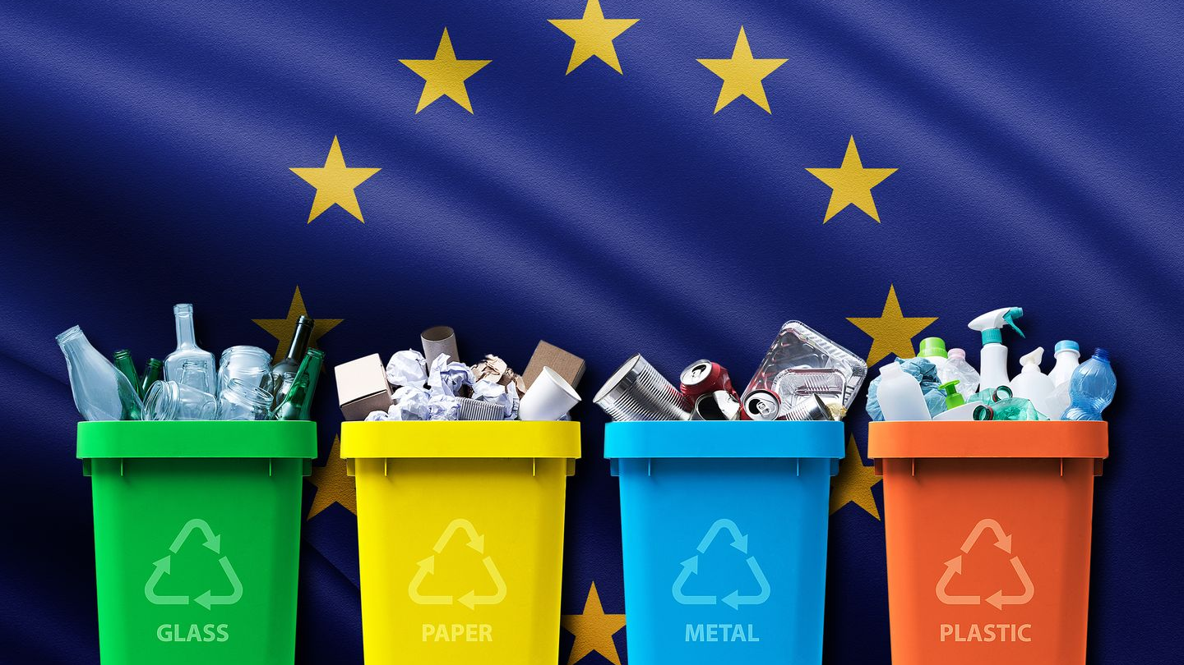
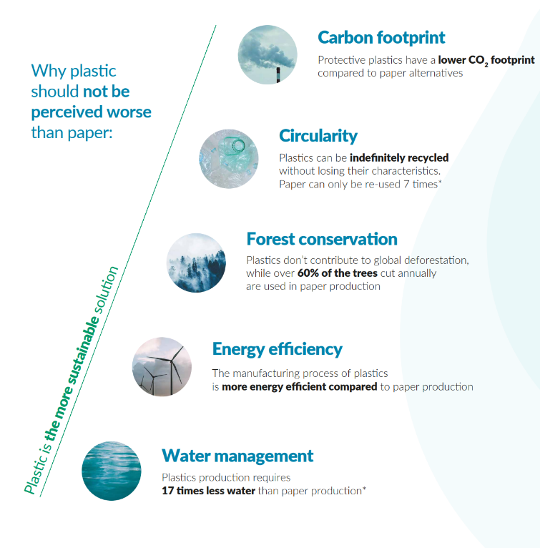
European PPWR
Packaging and Packaging Waste Regulation
Replace the Packaging Directive (1994)
Part of the broader Circular Economy Action Plan

Slide 7
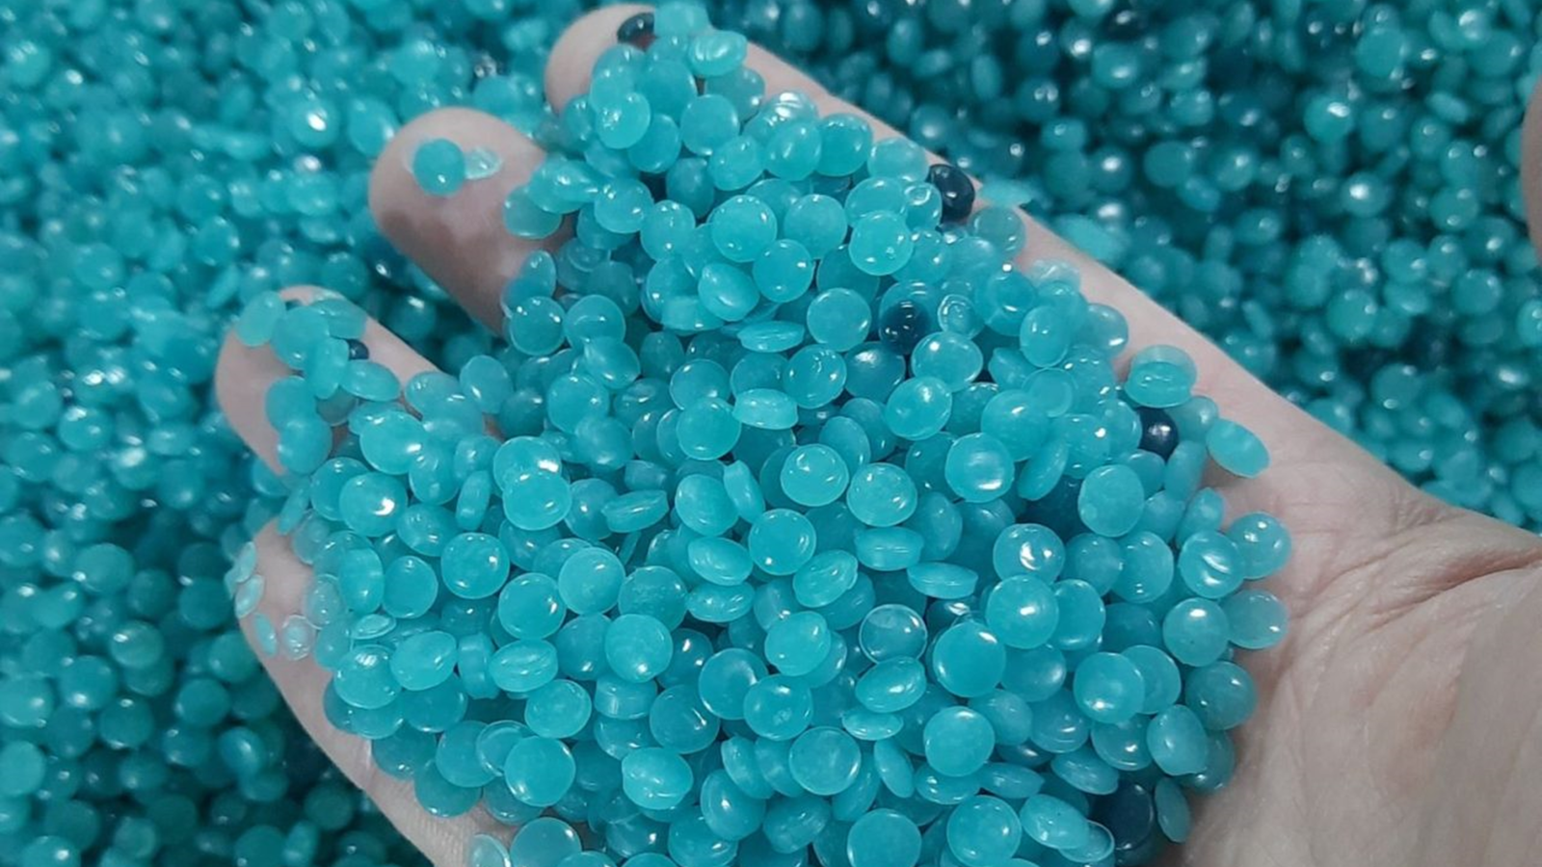
Design for recyclability
2030 EU market access only for recyclable packaging.
Packaging materials must be easier to collect, sort, and recycle, thereby reducing the overall environmental footprint.
Minimum Recycled Content
Minimum recycled content requirements for plastic packaging used across the EU by 2030.
Companies will be driven to use more recyclable and biodegradable materials into packaging products.
Driving reuse and refill
Encourage reuse systems for packaging while promoting the use of refillable packaging.
Reduce single-use packaging and promote alternatives where possible.
Waste minimization
Reduce packaging waste based on weight and encourage more efficient packaging designs.
Proposed bans on “unnecessary” packaging formats, including many single-use plastics.
Harmonized rules across the EU
Regulation instead of Directive to harmonize implementation.
Harmonized labelling on packaging and waste collection.
Focus on Extended Producer Responsibility (EPR) programs, where manufacturers and producers take on more responsibility for the entire lifecycle of the packaging they create.

Slide 8
Recycled content to be PCR by 2030
PCR = post-consumer recycled → Waste that has served its purpose for the customer
Minimum Recycled Content
Minimum recycled content requirements for plastic packaging used across the EU by 2030.
Companies will be driven to use more recyclable and biodegradable materials into packaging products.
Single use beverage bottles
30% by 2030
65% by 2040
PET contact sensitive
30% by 2030
50% by 2040
Other contact sensitive
10% by 2030
25% by 2040
Other plastics
35% by 2030
65% by 2040

Slide 9
Options to reduce the packaging waste should start from the 3R principle: Reduce – Reuse – Recycle
Waste minimization
Reduce packaging waste based on weight and encourage more efficient packaging designs.
Proposed bans on “unnecessary” packaging formats, including many single-use plastics.
Baseline per capita taken in 2018
1
5% weight reduction by 2030
2
10% weight reduction by 2035
3
15% weight reduction by 2040

Slide 10
Our Renew Portfolio – Aligned with PPWR Changes
As our Renew foam is 100% recyclable, it perfectly fits the requirement of design for recyclability.
Against Greenwashing
Our processes and products are certified by independent agencies, across the group and product categories
The minimum of 80% PIR is already a big step in the right direction; the use of PCR is being tested.
As foam is a lighter material than for example cardboard, and it is a closed-loop recycling method, waste is being minimized.

Slide 11
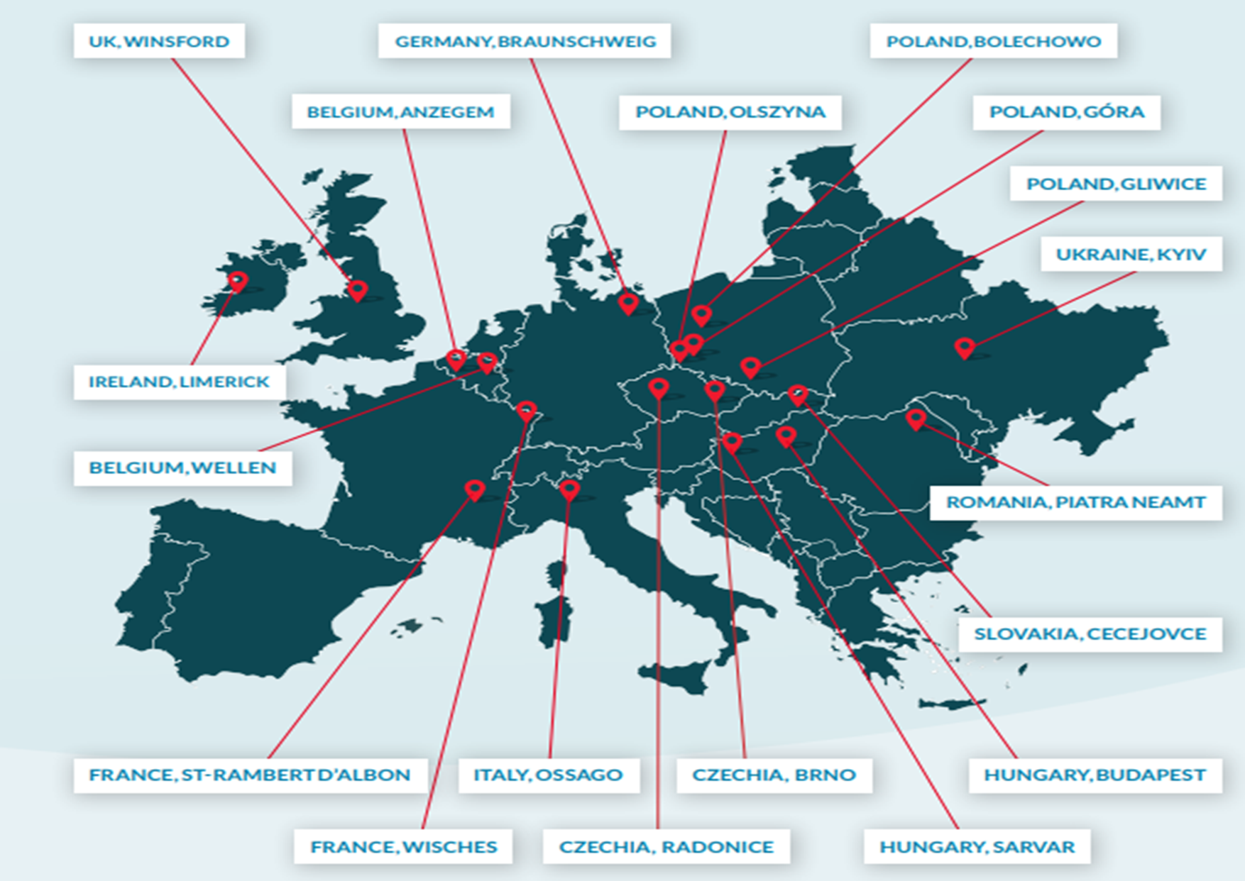
Our European presence lowers transport emissions
Due to our European presence, we always have a manufacturing plant nearby. Therefore tranport and transport emissions are minimized.
For Technical Foam, we have production capabilities in:
Limerick, Ireland
Wellen, Belgium
Wisches, France
Olszyna, Poland
Gliwice, Poland
Piatra Neamt, Romania

Slide 12
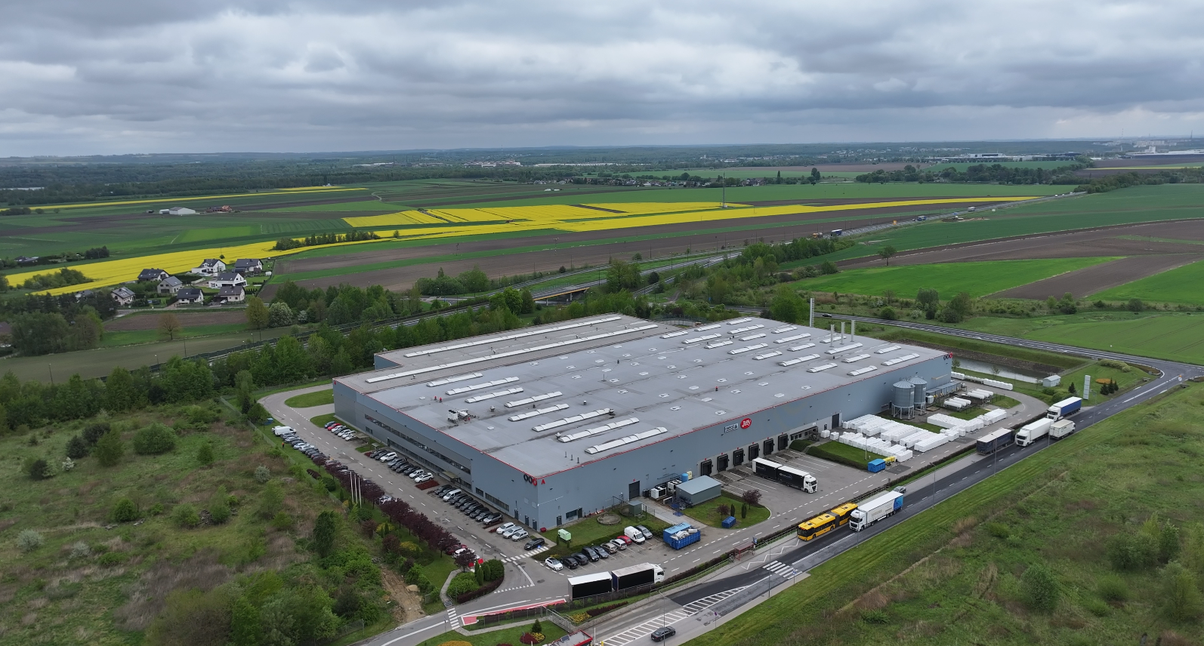

Slide 13
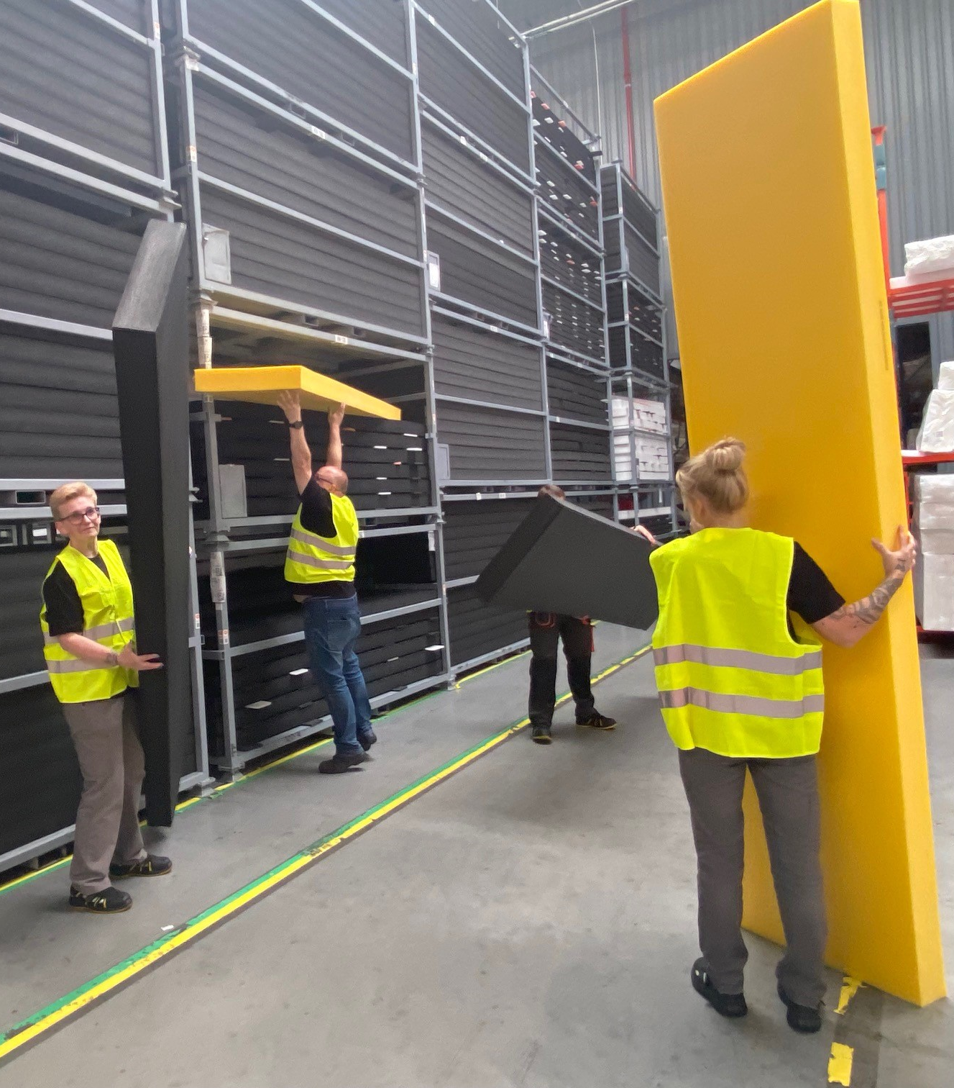
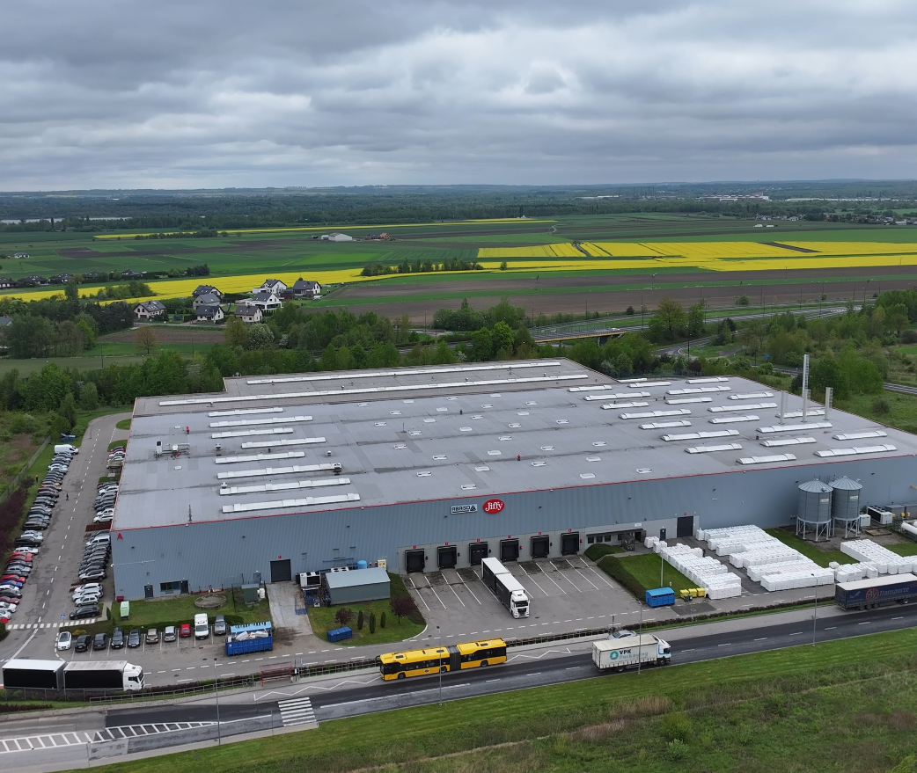
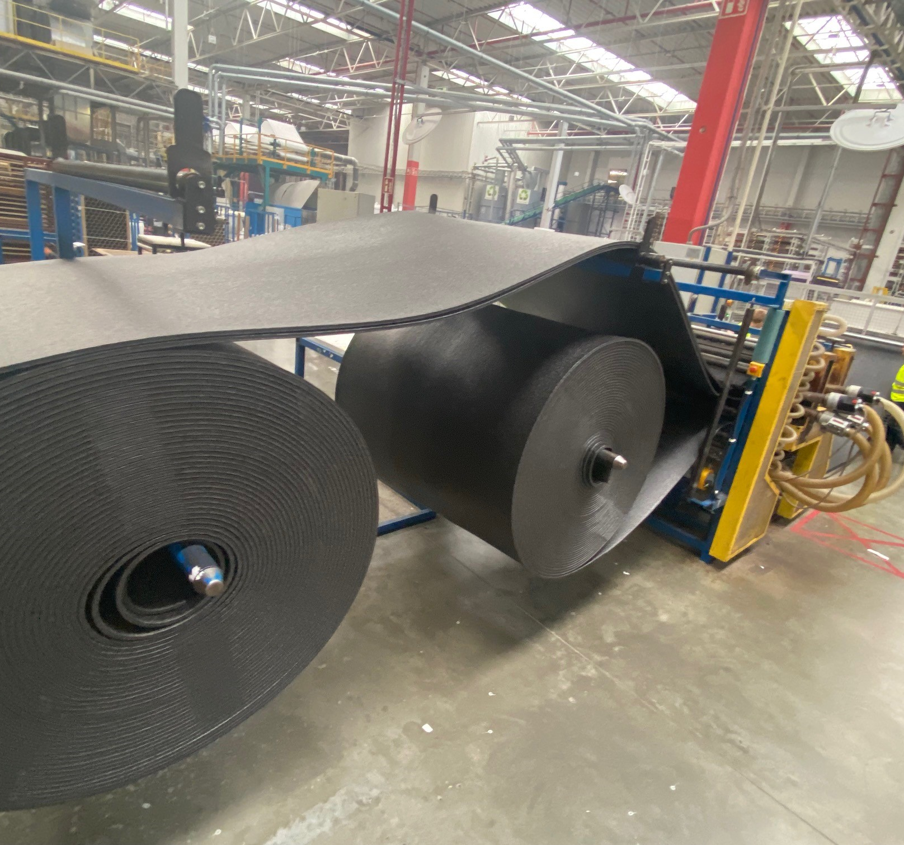

Slide 14
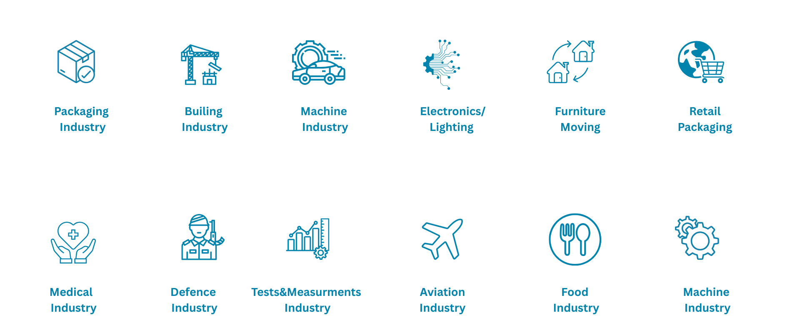
Industries

Slide 15
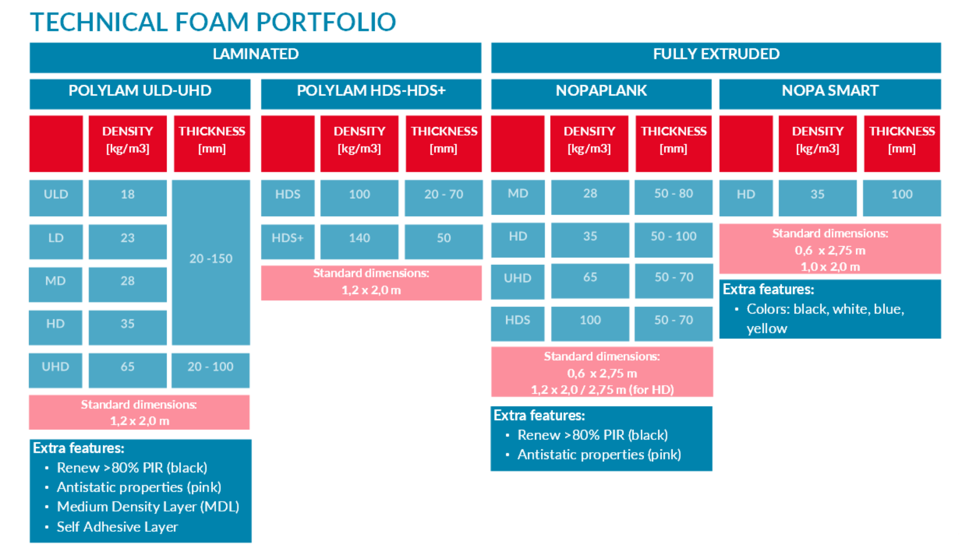

Slide 16
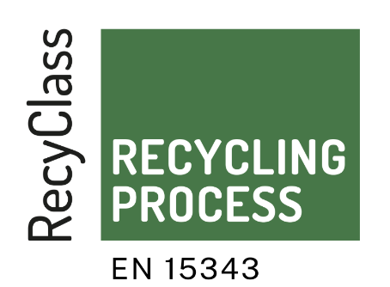
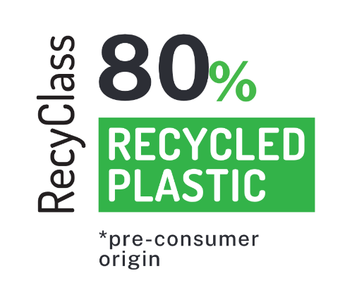
RENEW FOAM
Renew products are recycled-content versions of technical foams that contain at least
80% recycled content using waste from own manufacturing process and waste collected from our clients from closed-loop recycling.​
​
Renew foams are certified by Recyclass ​
and Polycert in Recycled Plastics Traceability schemes.

Slide 18
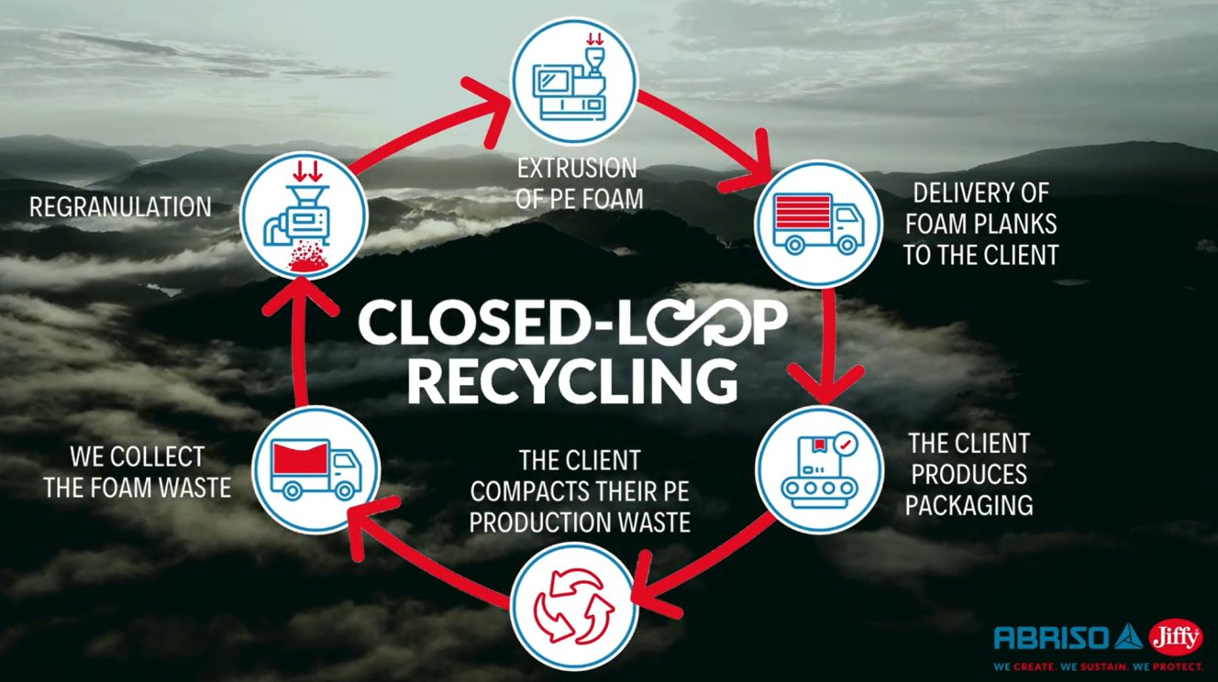

Slide 19
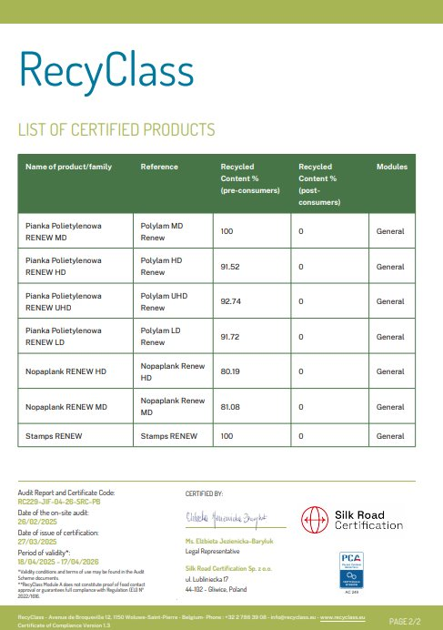
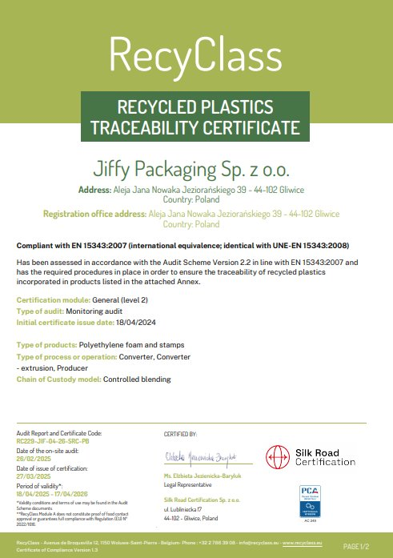

Slide 20
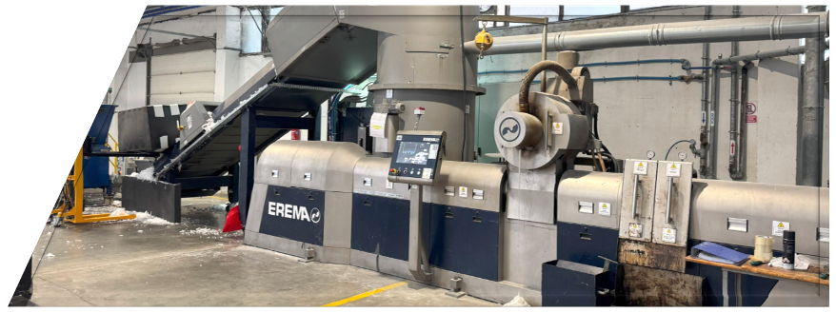
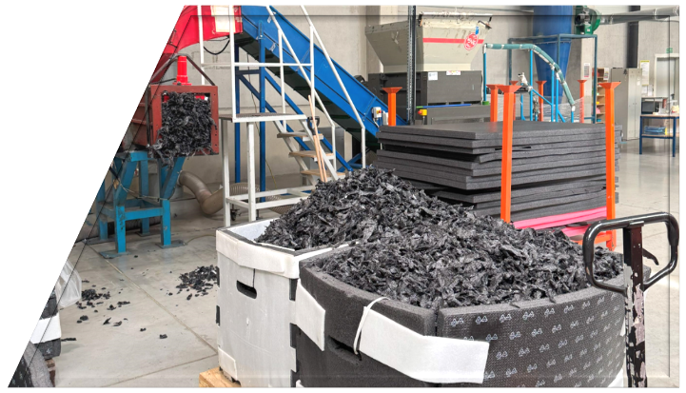
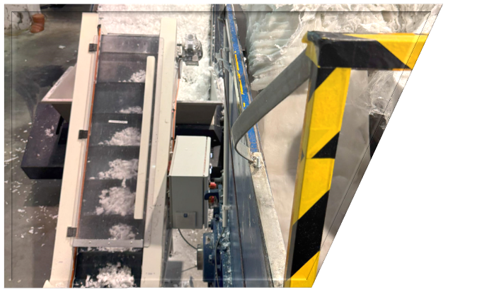
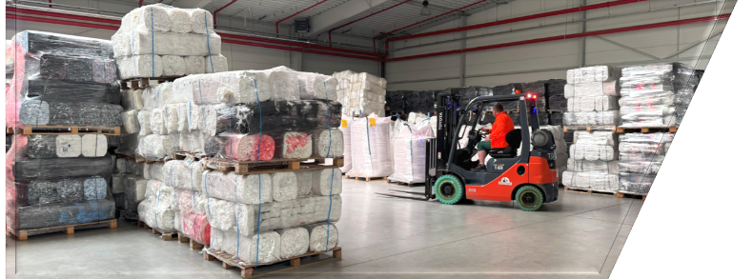

Slide 21
Technical Foam: Properties & Applications

Slide 22
Why choose Technical Foam?
Protection during transport
Shock & impact protection
Protection against scratches & surface damage
Non-crosslinked & toxic-free
Moisture-resistant
100% recyclable

Slide 23
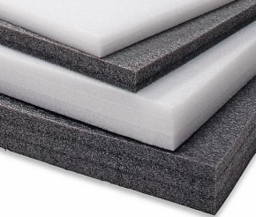
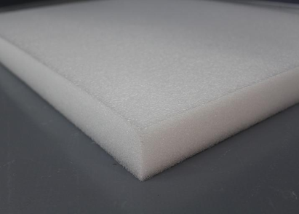
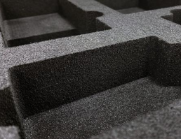
Recap: Comparison Table
Thermally Laminated | Fully Extruded | Fully Extruded
Good shock absorption | Excellent shock absorption | Great shock absorption
Great flexural strenght | Great compressive strength | Good compressive strength
Smooth surface | Slightly rougher surface | Very smooth, velvety surface
Ideal for light packaging | Heavy protection & cushioning | Delicate surfaces & presentation packaging
Polylam
Nopaplank
Nopasmart

Slide 24
Get in touch
Mathias Van Hecke
Strategy & Sustainability
Mvanhecke@abrisojiffy.com
Aneta Skora
Sales Manager CEE & Nordics
Askora@abrisojiffy.com
Iwona Szelag
Team leader Technical Foam
Iszelag@abrisojiffy.com
Or for more general questions, contact us at marketing@abrisojiffy.com

